Slide 1
AUGMENTED REALITY : Implementation using Kinect
By
Ishaan Dube
Narendra Roy
Atri Bhattacharyya
Mentors:
Anurag Dwivedi
Nikhil Gupta

Slide 2
Overview
Basics of Kinect
Softwares Used
About XNA
Demonstration
Further Developments and Utility

Slide 3
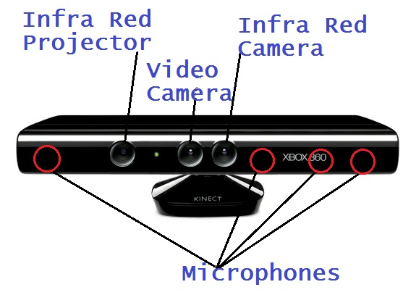
Microsoft Kinect

Slide 4
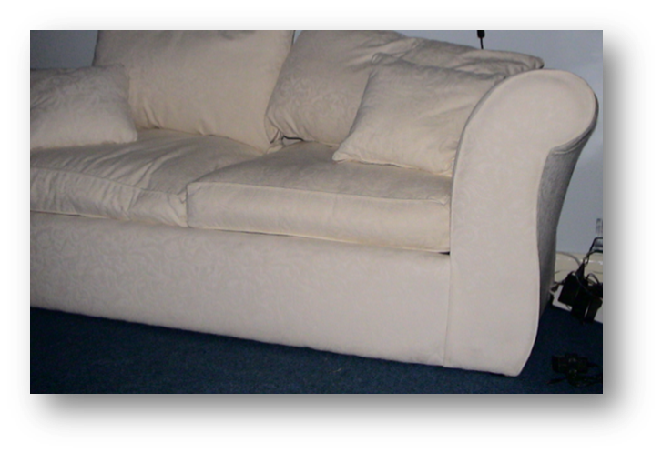
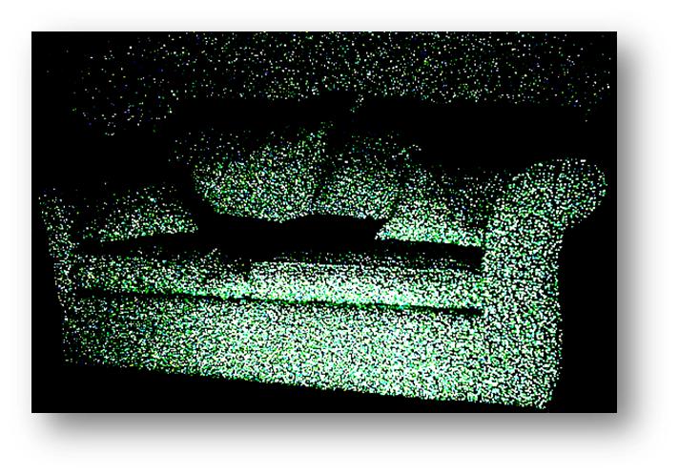
DEPTH DATA

Slide 5
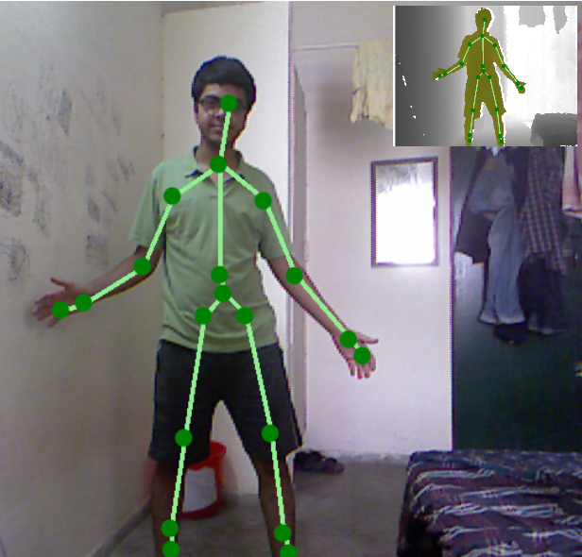
SKELETON TRACKING

Slide 6
Softwares Used
Visual C# Express : C# programming language used
Kinect for Windows SDK
-to write Kinect Apps
Microsoft XNA Game Studio 4.0
- a managed runtime environment provided by Microsoft that facilitates video
game development and management.

Slide 7
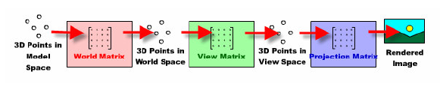
How we used XNA
We manipulated and rendered 3D objects
We require three matrices for displaying 3D objects
World matrix
View matrix
Projection matrix

Slide 8
Our Approach
Get skeleton data and manipulate positions of Joints for tricks
Using gestures like clapping,waving of hand,etc.
Use coordinates of tracked points for displaying objects at appropriate place and rescaling them
Use depth data to uniquely detect the player if required

Slide 9
Demonstration

Slide 10
Further Developments
Enable voice Commands.
Enable better gestures , and possibly store gestures as XML files and have advanced processing for better gestures.
Add sparkles and other tricks to improve the show.

Slide 11

Future Scope

Slide 12
Thank You!
Any Questions?

